Slide 1
Gendered Pronoun Resolution
Data Analysis Assignment
Matthew Miller
BIA 686
Prof. Asakiewicz
Mar 25, 2018

Slide 2
Research Question and Motivation
Question:
Can we successfully identify the subject to which a pronoun belongs?
Motivation:
Google AI has released new GAP dataset after identifying that previous models to do this task have had unsatisfying results due to an imbalance in the gendered examples used for training
Example: The salesperson sold some books to the librarian because she was trying the sell them before Friday.

Slide 3
Goal:
To use machine learning and natural language processing on Google’s new gender balanced GAP dataset to create a model which correctly identifies the subject associated with ambiguous pronouns.
Kaggle Link: https://www.kaggle.com/c/gendered-pronoun-resolution

Slide 4
Original Data Structure
Columns
ID - Unique identifier for an example (Matches to Id in output file format)
Text - Text containing the ambiguous pronoun and two candidate names (about a paragraph in length)
Pronoun - The target pronoun (text)
Pronoun-offset The character offset of Pronoun in Text
A - The first name candidate (text)
A-offset - The character offset of name A in Text
A-coref – Whether pronoun refers to name A
B - The second name candidate
B-offset - The character offset of name B in Text
B-coref - Whether pronoun refers to name B
URL - The URL of the source Wikipedia page for the example

Slide 5
Exploratory Data Analysis – Part 1
Distribution of Pronoun Assignment
Distribution of Correct Assignment of Pronoun to Subject
Data is distributed fairly evenly between pronouns associated with the first subject versus the second, with about 10% not being associated with either
Pronoun Classification | Entries | Percent of Total
A | 874 | 43.7%
B | 925 | 46.3%
Neither | 201 | 10.1%

Slide 6
Exploratory Data Analysis – Part 1
Distribution of Pronouns
Distribution of Pronouns Used
As expected, the total distribution of masculine and feminine pronouns is exactly split 50/50
Surprisingly, this training dataset has no use of ‘hers’, though within comments made in the Kaggle competition discussion, it is possible that ‘hers’ will be included in the second stage dataset.
Pronoun Type | Pronoun | Gender | Total | Percent | By Type
Subject | He | M | 373 | 18.7% | 40.1%
 | She | F | 428 | 21.4%
Possessive | His | M | 529 | 26.5% | 55.1%*
 | Her(s)* | F | 572 | 28.6%*
Object | Him | M | 98 | 4.9% | 4.9%*
 | Her* | F | 0 | 0.0%*

Slide 7
Added/Modified Features
Created “PronounClass” feature to transform the A-Coref and B-Coref fields into a single field
Made “pronoun” case insensitive
Created feature for “OffsetPronoun-A” and “OffsetPronoun-B” which calculates character distance from the pronoun to subject A/B
Created feature “SentenceClass” to identify sentences as:
FinalPro – where pronoun appears after both subjects
MiddlePro – where pronoun appears between subjects
InitialPro – where pronoun appears before both subjects
Created feature “PronounType” to distinguish between:
Subject Pronouns – he/she
Object Pronouns and Possessive Pronouns – him/her/his/her/hers
Difficulty found in that ‘her’ can act as both object and possessive pronoun, so it was difficult to split further, though as seen previously, ‘him’ only occurred 5% of the time

Slide 8
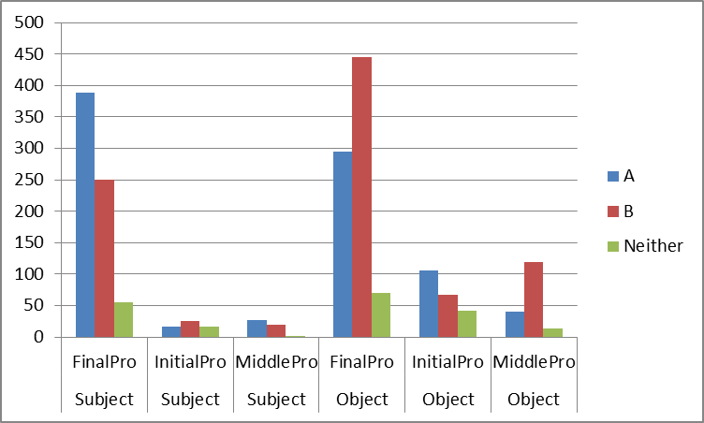
Exploratory Data Analysis – Part 2
Pronoun Assignment Vs. Pronoun Type and Sentence Type
Subject pronouns typically assigned to the first subject, while object pronouns seemed to typically be assigned to the second subject
Pattern is swapped for InitialPro sentences
FinalPro sentences drastically outweigh the other two types of sentences

Slide 9
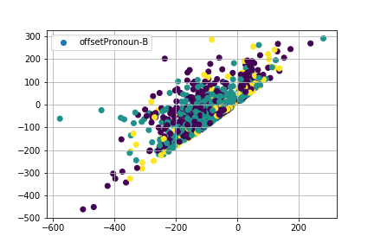
Exploratory Data Analysis – Part 2
Scatterplot of Pronoun-subject Offsets vs Pronoun assignments
Using just the character offset between the pronoun and the subject does not seem to give a good enough distinction, but it may offer some additional input later on.
Purple – A
Teal – B
Yellow – Neither

Slide 10
Next Steps
Features
Generally, plan on using CountVectorizer on sentences to try and create sentence vectors
See if count of how often subject appears in excerpt has predictive value
Try using vectors themselves as input into model
Lemmatized words
Finding the word offset between pronouns and subjects
Data Modeling:
Use simple and complex models to create predictions using these methods
RF, SVM
Use stacking to combine different models to get better predictions
Neural Nets

Slide 11
Questions?

